Slide 1
Biochemistry of Electron Transport
Pathway of the e- from NADH → O₂
Chemiosmotic Hypothesis
Synthesis of ATP

Slide 2
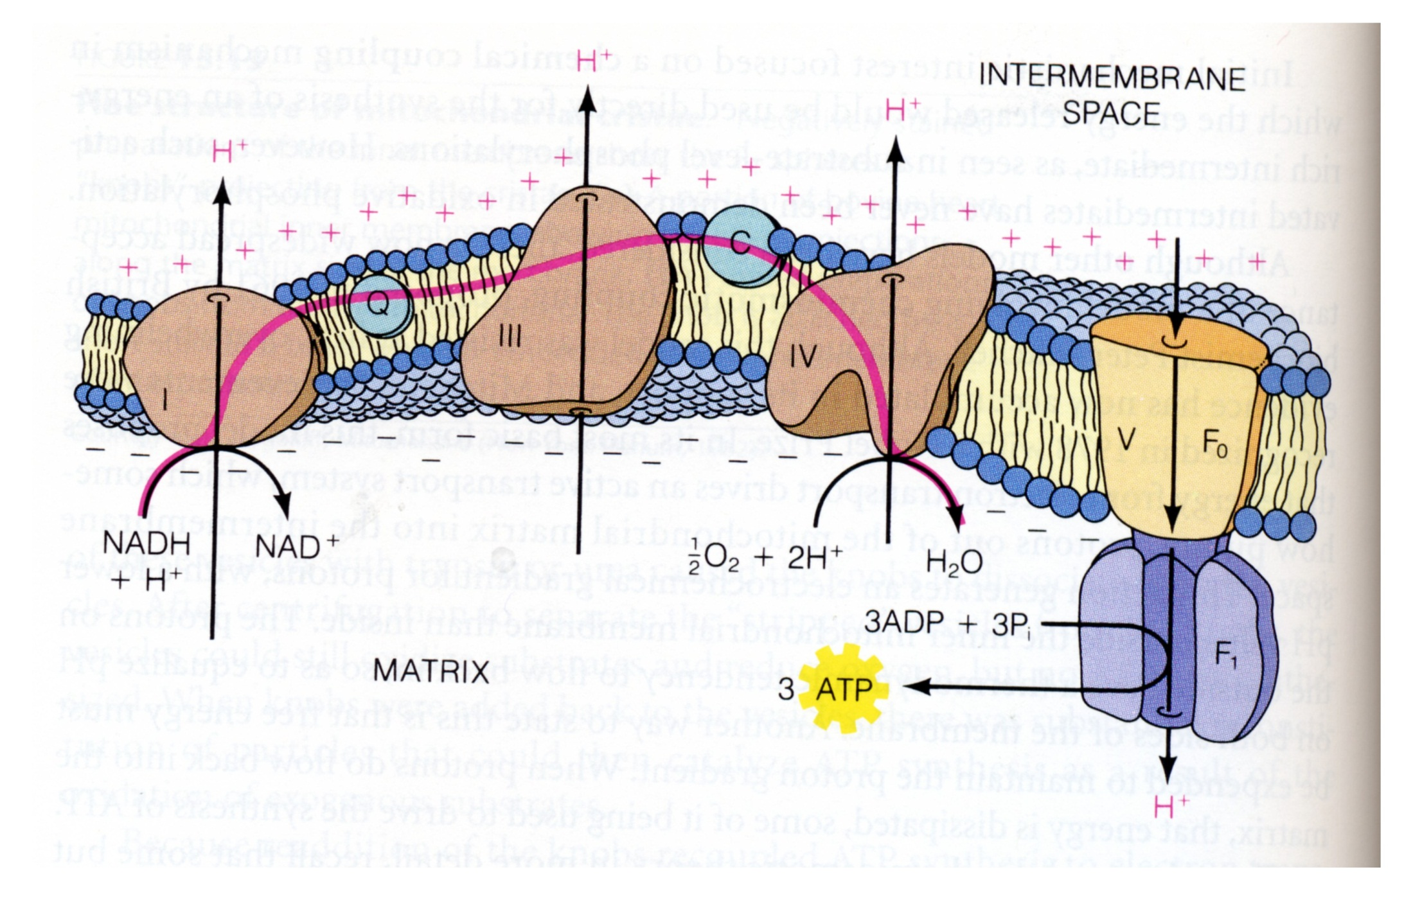
II

Slide 3
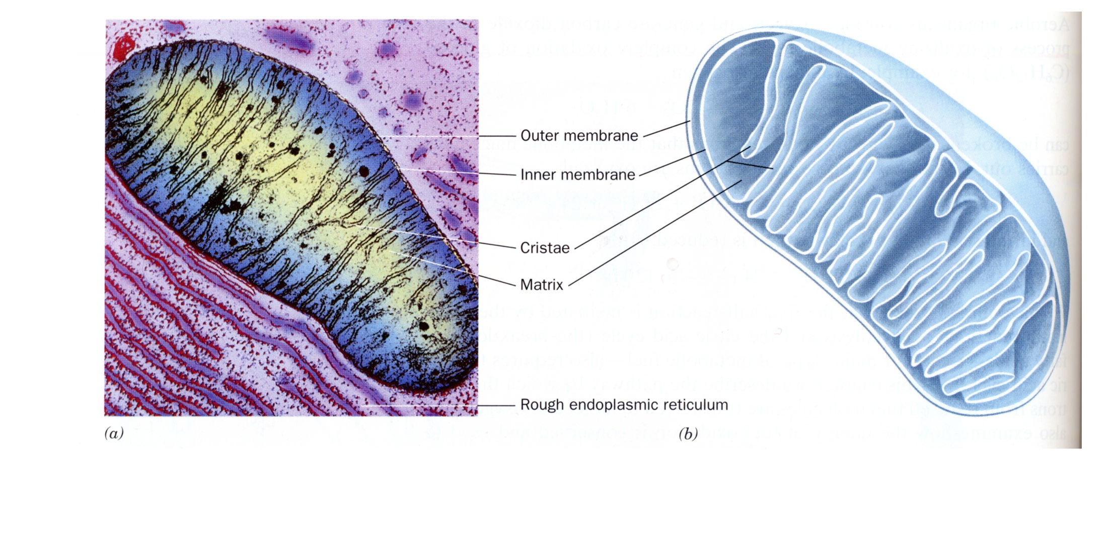

Slide 4
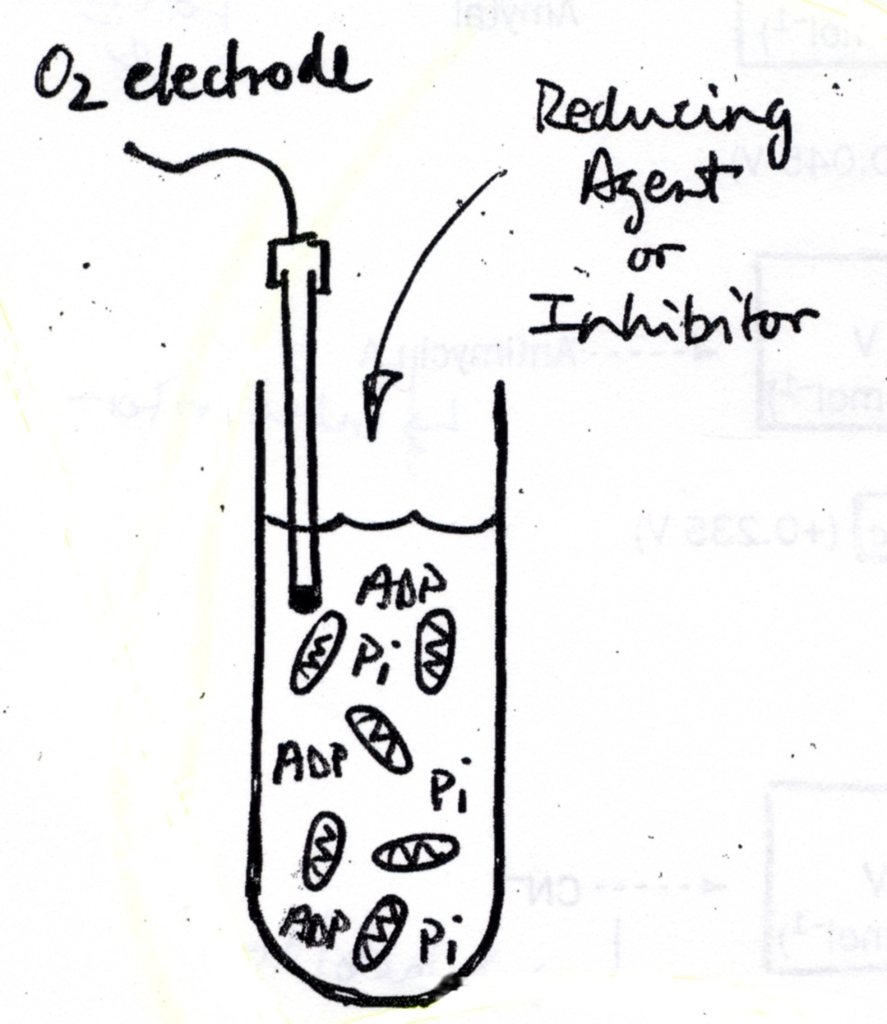
“Artificial Respiration”: Experiments that led to Understanding the sequence of Electron Transport Proteins

Slide 5
Electron Donor Systems
O
H
1
2
Succinate Fumarate
H
C
C
O
O
3
FAD
FADH₂
β-OH-butyrate
NAD⁺
Ascorbic Acid + TMPD(tetramethyl phenylenediamine)
cyctochrome C
3
NADH + H⁺
2H
O
H
C
C
O
O
3
2H
acetoacetate

Slide 6
Where do electrons enter the ETC?
Use: Inhibitors of electron transport

Slide 7
Antimycin a
Rotenone/ amytal
CN
II

Slide 8
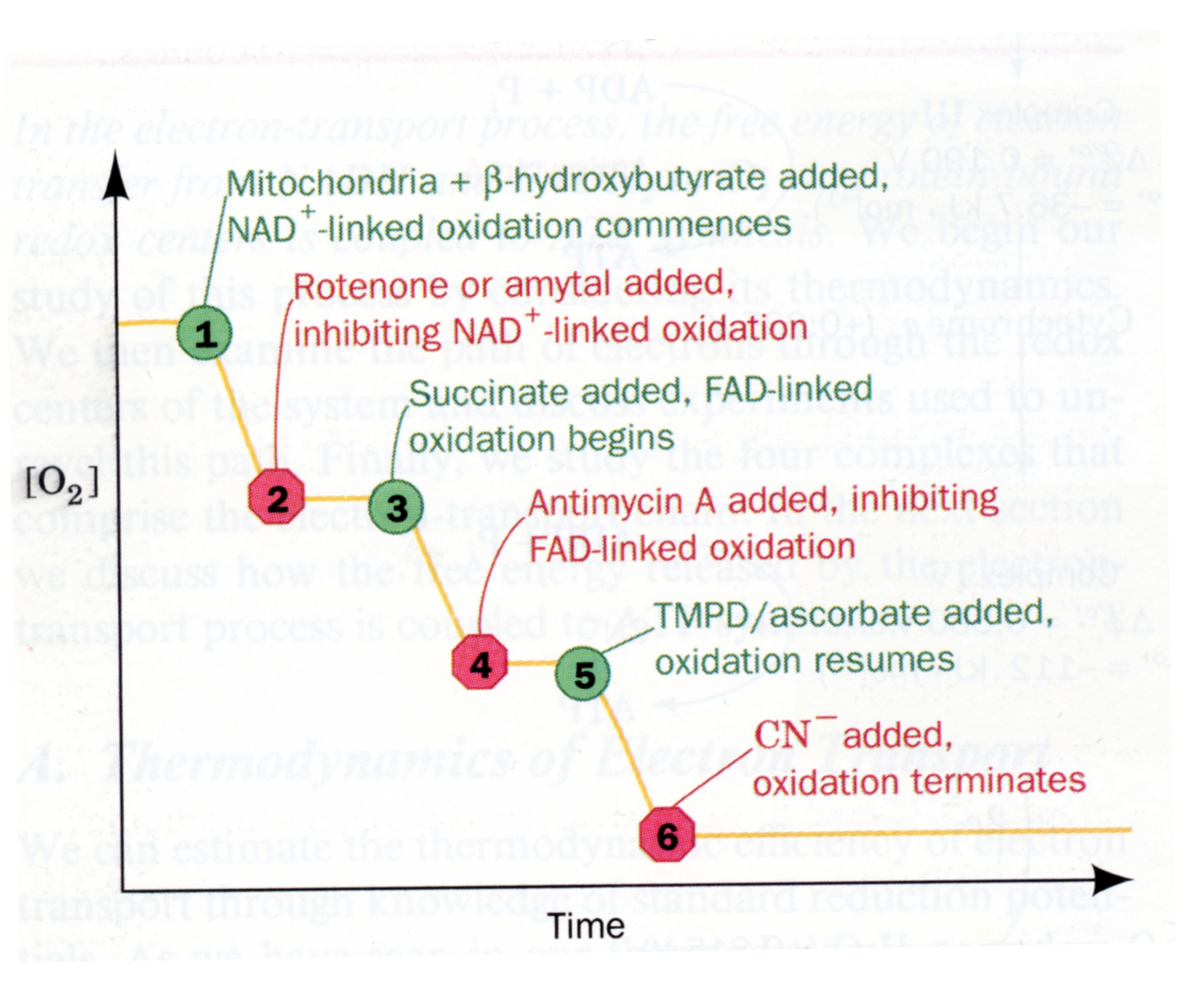

Slide 9
TMPD
Ascorbate
FADH₂
II

Slide 10
The Oxidation of NADH or FADH₂ by O₂ is Tightly Coupled to the Phosphorylation of ADP
How many moles of ATP are synthesized from the reduction of 1 mole O₂ ?
1 O₂
nADP + nP_{i}
2 H₂0
nATP
Measure the amount of O₂ consumed (reduced to 2H₂O) for any given amount of ADP added.
Experimental Conditions
- same as the inhibitor expt (no ADP initially, excess PO₄)
- isolated mito’s in buffer containing excess phosphate
- addition of ADP + an electron donor starts electron transport

Slide 11
ADP is limiting!
NADH, Pi, O₂ are in excess.

Slide 12
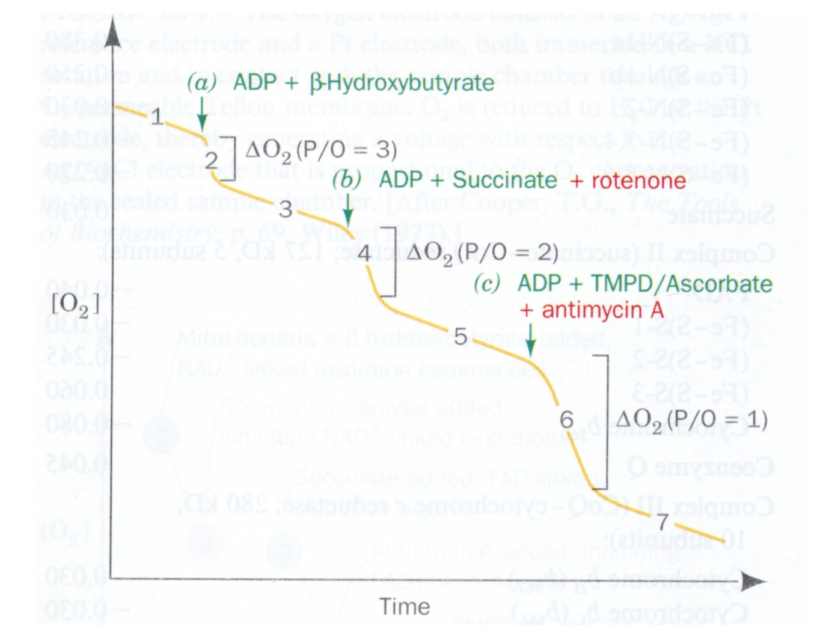
O₂ Consumption as a function of ADP P’n
ADP=90 umoles
(90 micromoles)
18 umoles
30 umoles
45 umoles
Conditions: Isolated mitochondria in buffer containing excess PO₄. Reaction is initiated by addition of ADP and e- donor.

Slide 13
Interpretation of Results
a) β-OH-butyrate
Conversion of 90 umol ADP (or PO₄) → ATP requires 18 umol O₂ (36 umol O)
P/O = 90/36 = 2.5
b) Succinate
Conversion of 90 umol ADP (or PO₄) → ATP requires 30 umol O₂ (60 umol O)
P/O = 90/60 = 1.5
c) TMPD/Ascorbate
P/O = 90/90 = 1

Slide 14
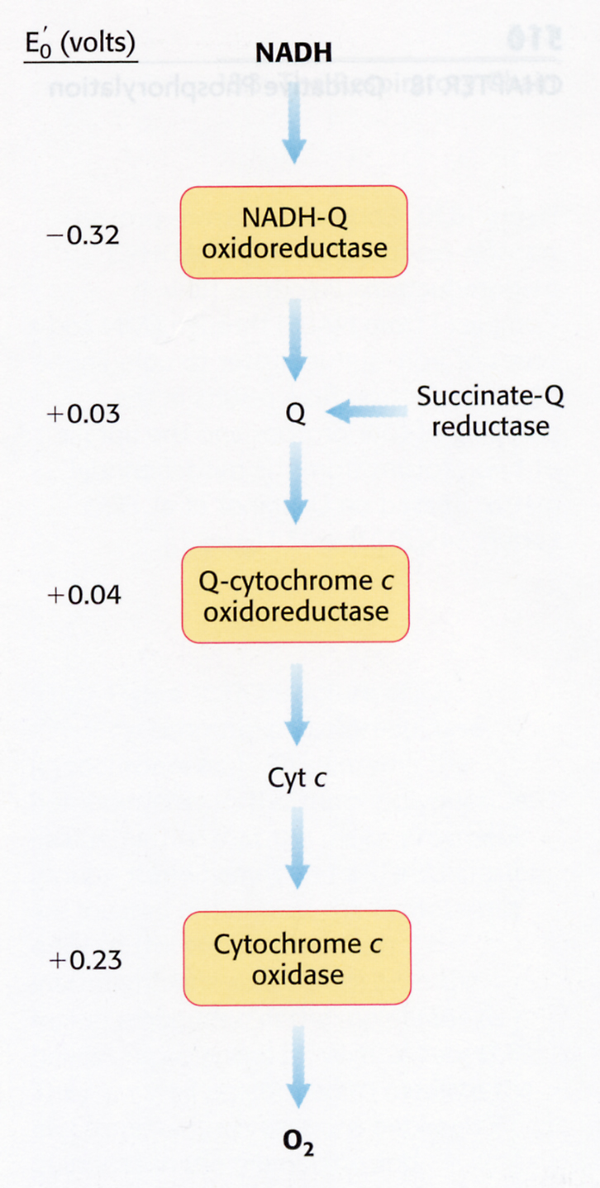

Slide 15
How many protons are pumped for every electron pair?

Slide 16
TMPD
Ascorbate
FADH₂
II

Slide 17
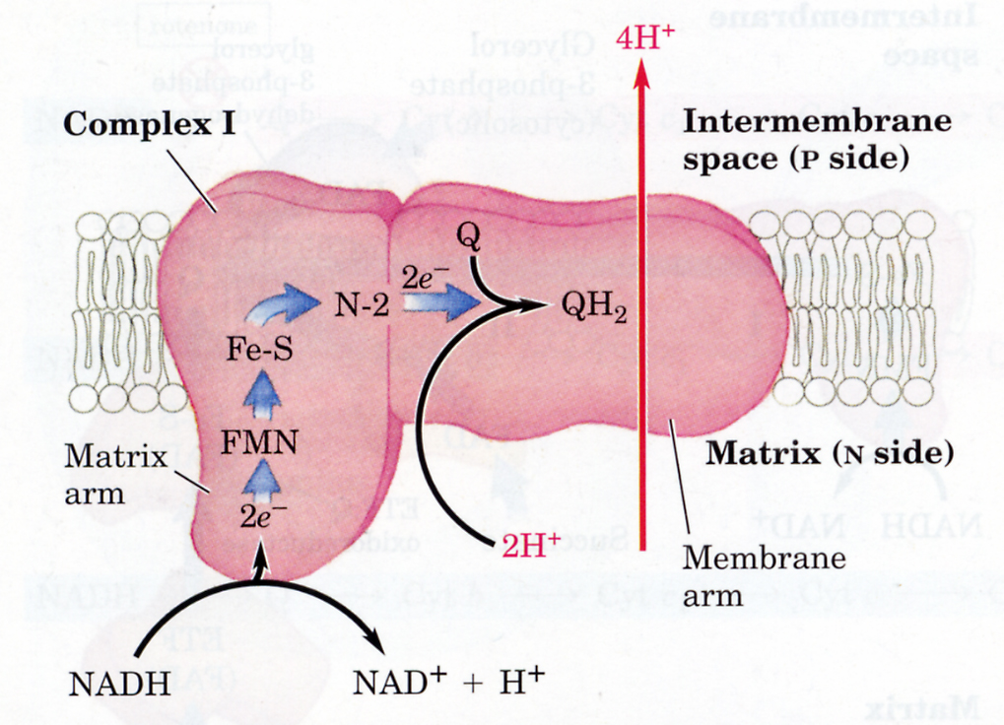
Complex I
Lehninger Fig 19-9

Slide 18
Four Types of Redox Centers in the Electron Transport Chain
Flavins – FMN, FAD
Iron – Sulfur Centers [2Fe–2S], [4Fe-4S]
Hemes
Cu Ions

Slide 19
Complex I
Lehninger Fig 19-9

Slide 20
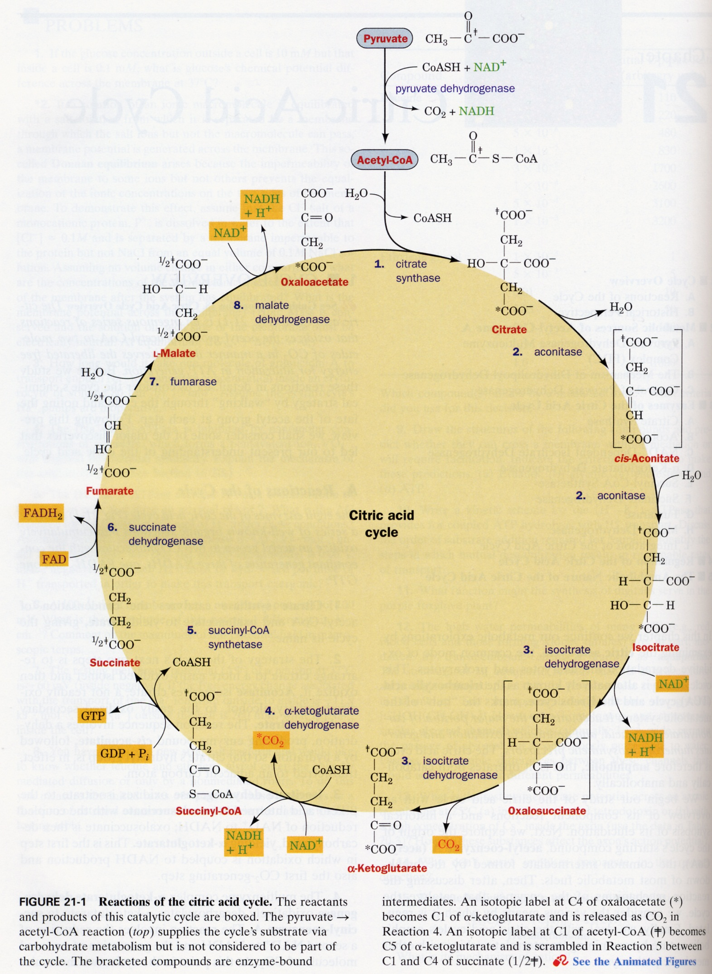
•
•
Q
Complex II

Slide 21
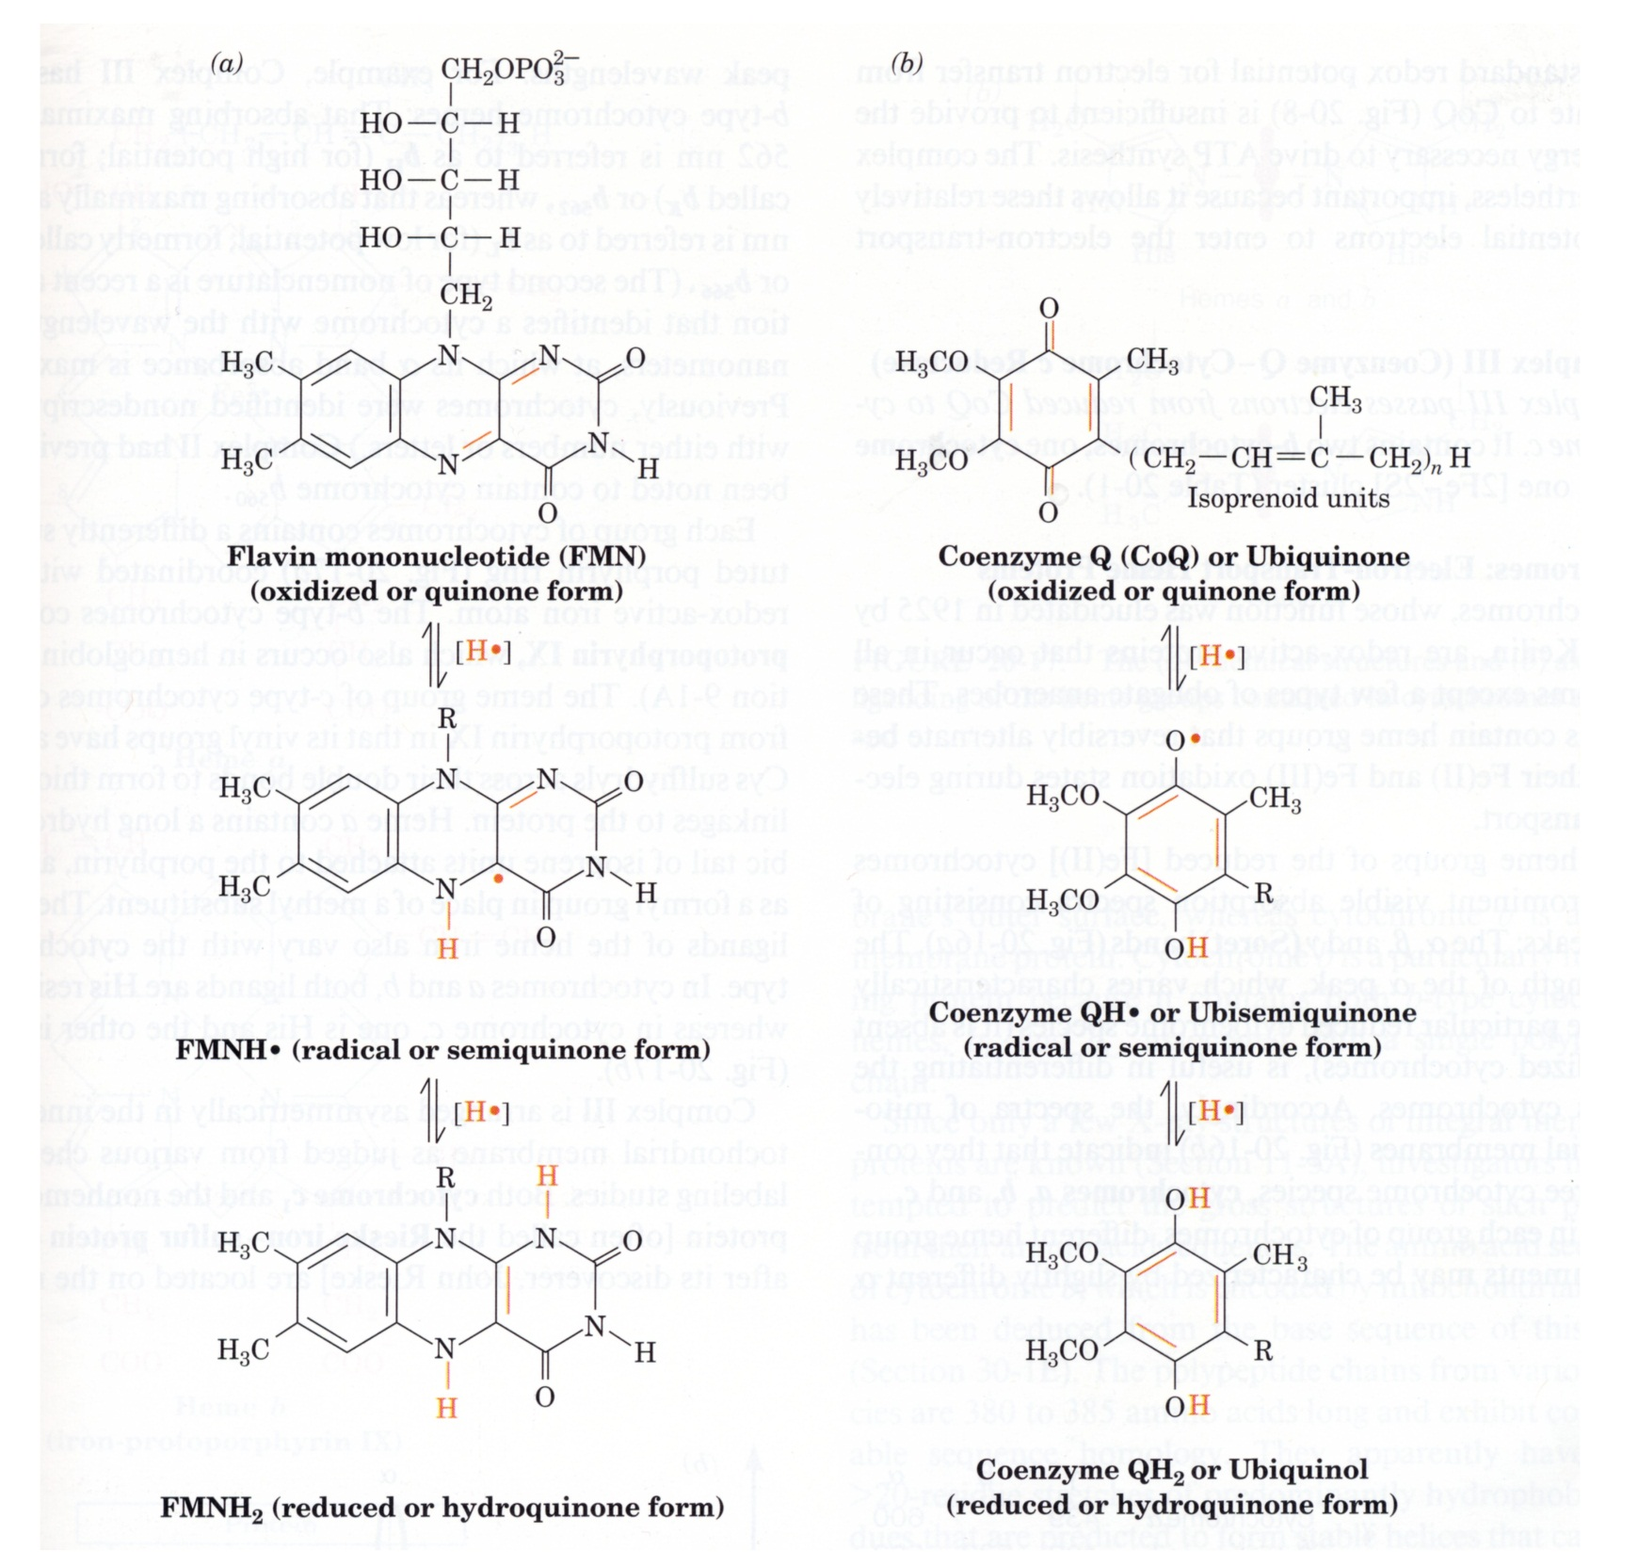

Slide 22
• Oxygen is a bi-radical
• Can accept e-s only 1 at a time
• Problem: ETC starts with e- pairs….
• O₂ •

Slide 23
TMPD
Ascorbate
FADH₂
II

Slide 24
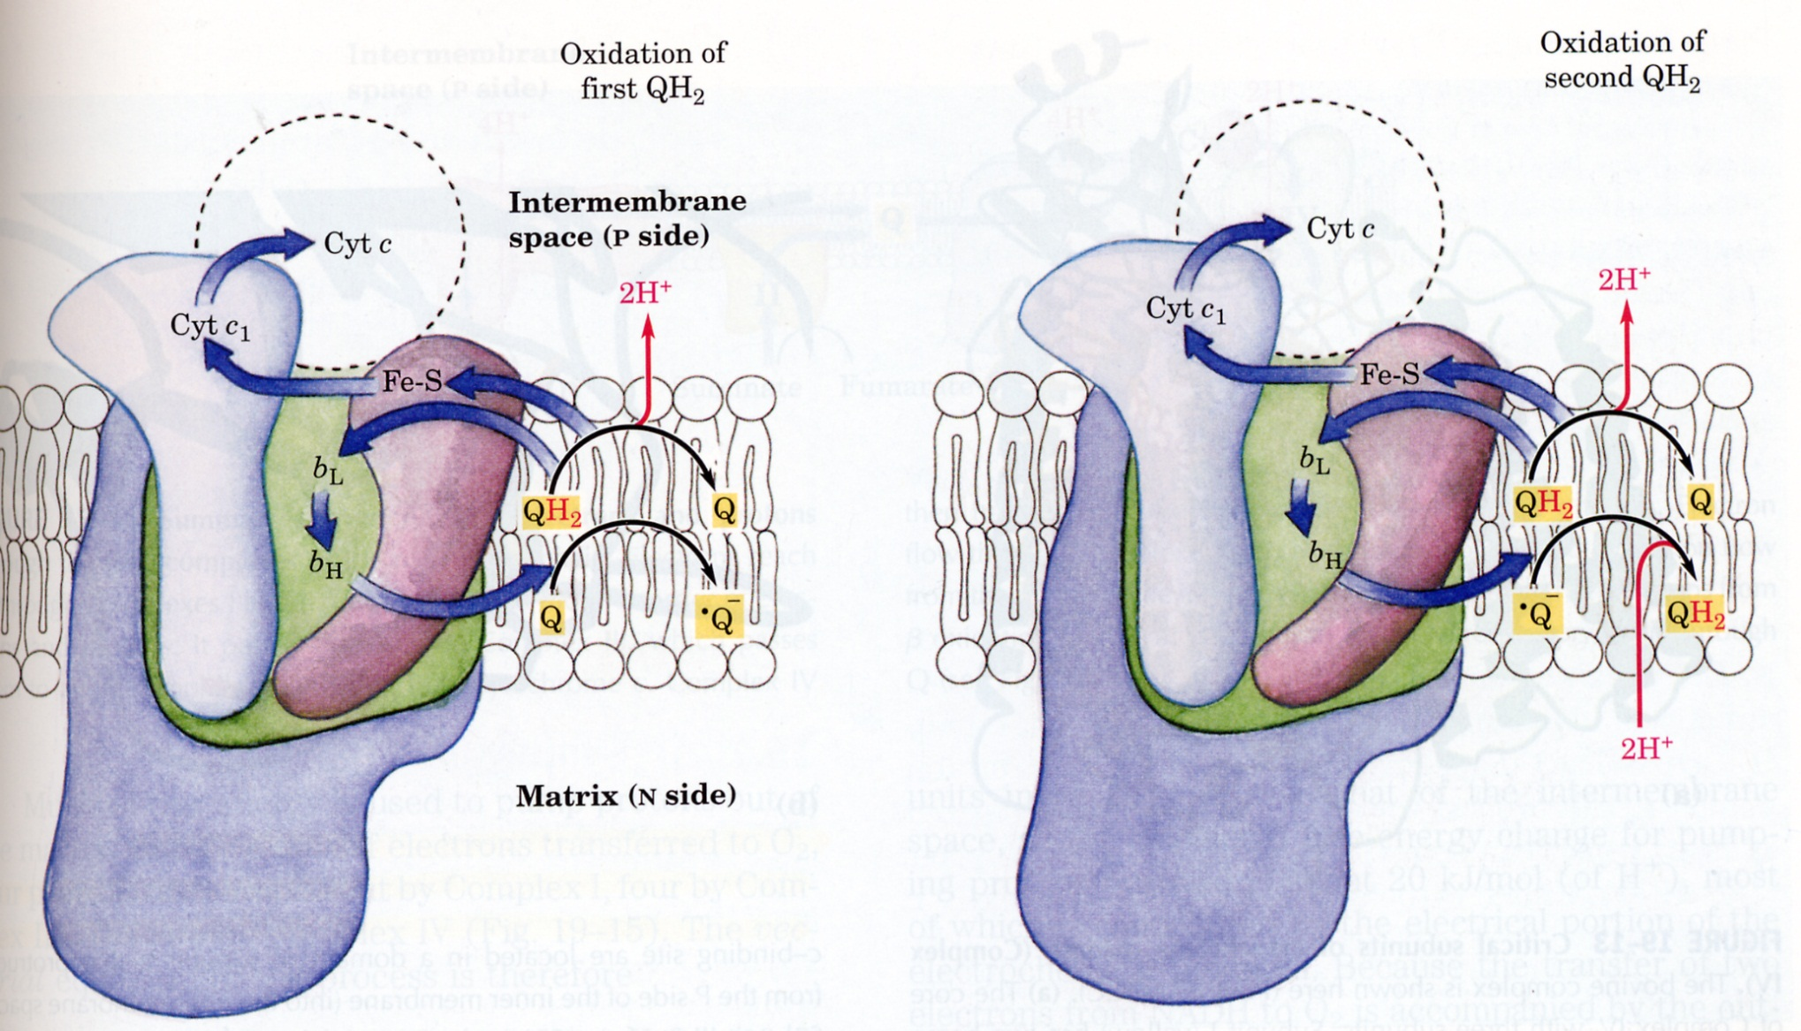
Complex III
Lehninger Fig 19-12

Slide 25
Complex I
Lehninger Fig 19-9

Slide 26
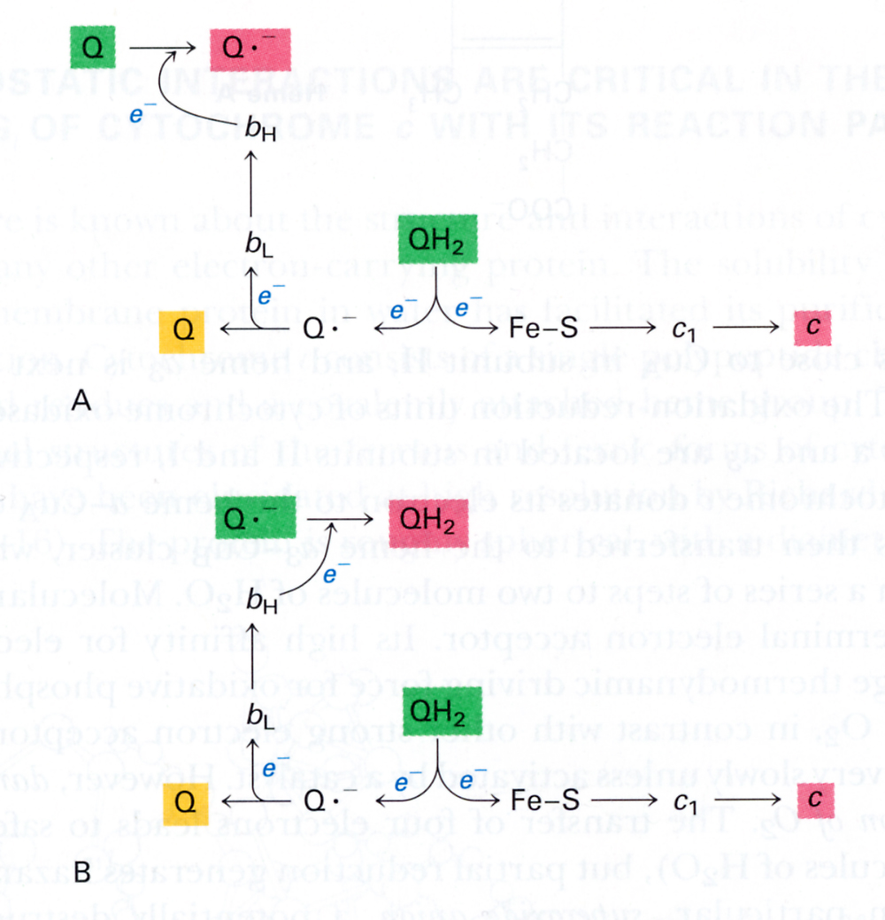

Slide 27
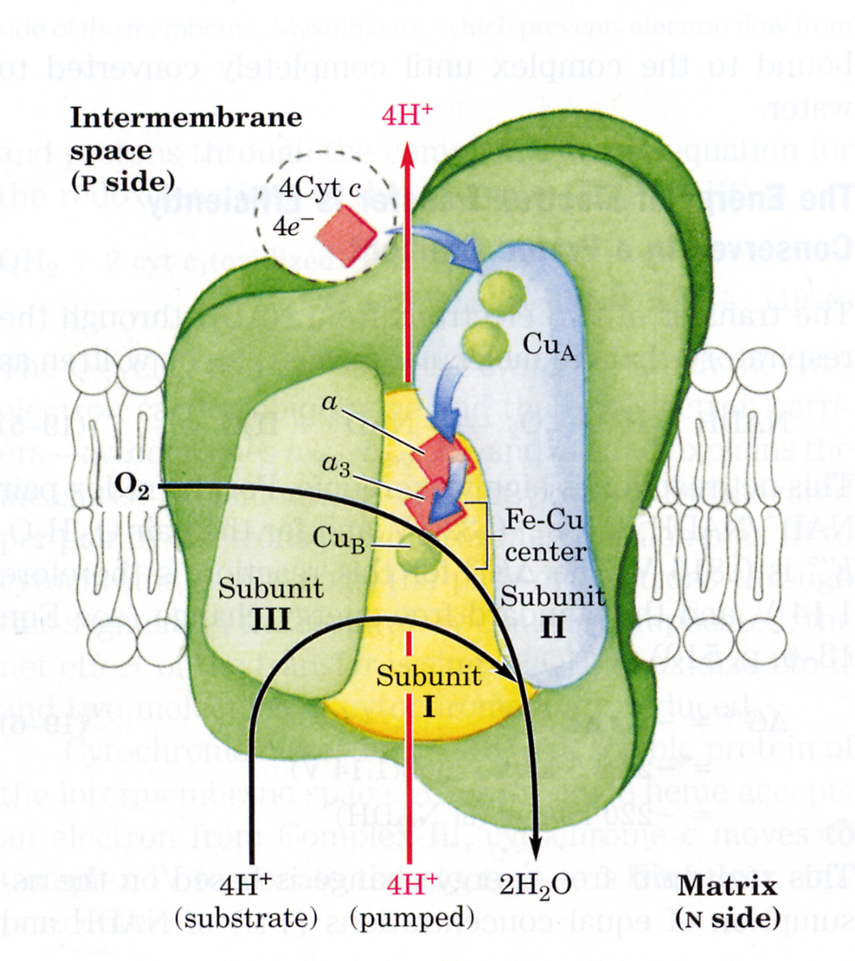
Complex IV (cytochrome oxidase)

Slide 28
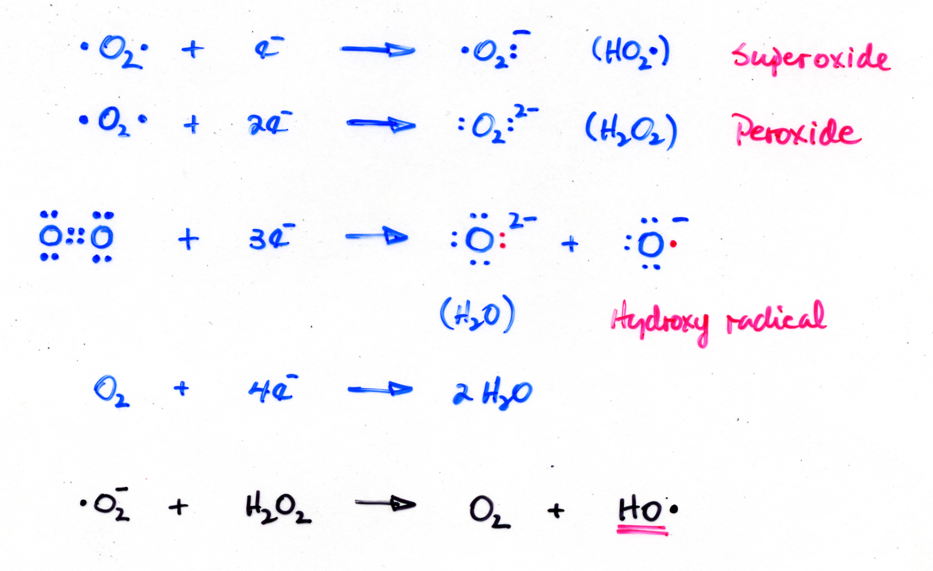
Oxygen free radicals

Slide 29
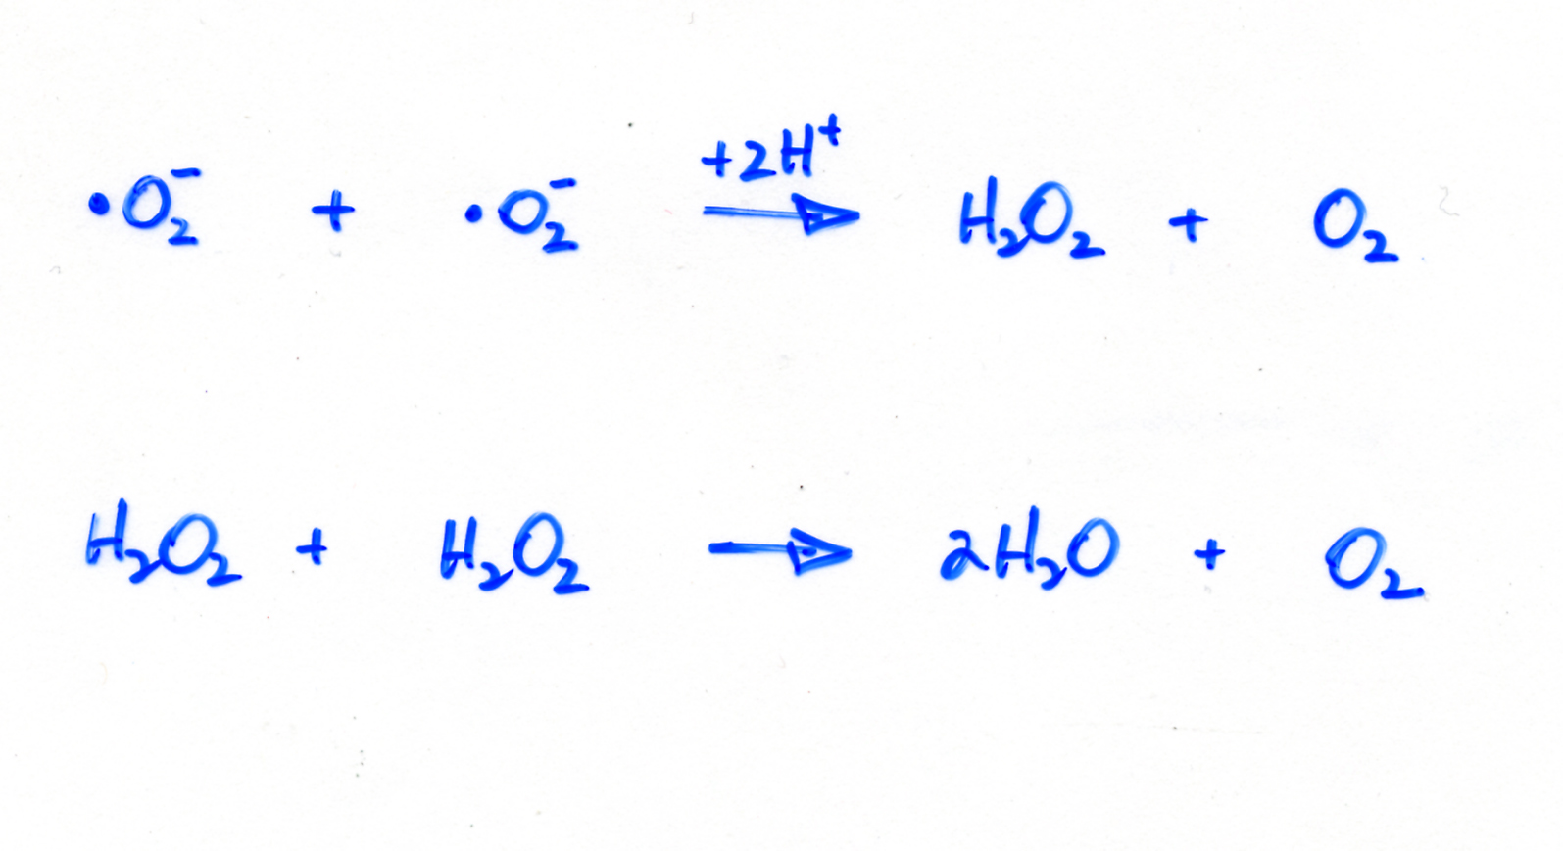
O₂ free radical scavaging systems
Superoxide Dismutase
Catalase

Slide 30
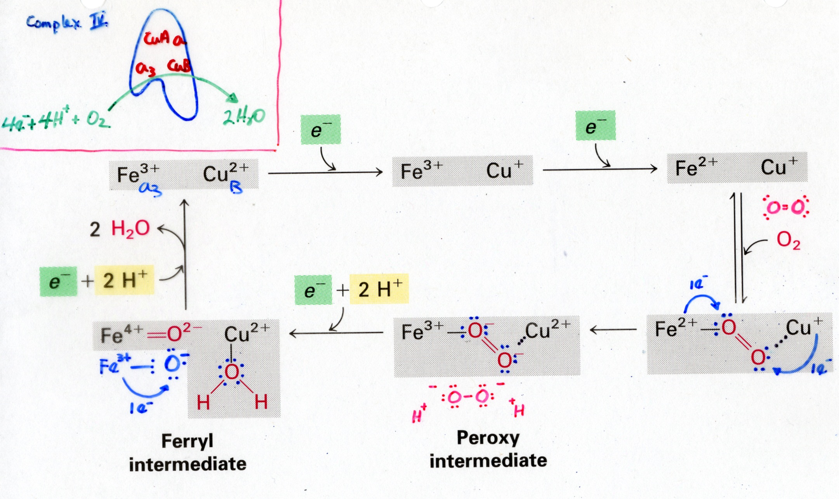

Slide 31



10 H⁺’s are pumped per 2e⁻s transported from NADH to ½ O₂
+ H⁺
+ H⁺
Look at Fig. 19-19 Lehninger

